Slide 1
Read me
Welcome to the Presentation Templates Deck!
This deck contains a collection of presentation templates designed for use across our organization. Please follow these guidelines to ensure proper usage:
Make a Copy:
Before you start working on a presentation, make a copy of this template. Do not edit the original deck to maintain its integrity for others.
How to Copy:
Click on "File" in the top menu.
Select "Make a copy" and choose your preferred location in your drive.
Template Structure:
Each template includes predefined layouts, fonts, and color schemes that align with our branding guidelines.
Feel free to customize content, but please keep the overall design consistent.
Feedback and Suggestions:
If you have ideas for improvements or additional templates, please share them with the design team.
Support:
For any questions or assistance, reach out to the design team.

Slide 2
Slide Sections
Content slide: Link Slide Breaker: Link Pre-made Slides: Link
Generic Slides: Link
Team Representation: Link
Infographics: Link
Demos/Product Listing: Link
List features: Link
Feature Cards: Link
Workflows (CAI): Link
Tech Stack: Link
Process flows: Link
Lists/Tables: Link Charts(Gantt): Link
Timelines: Link
Case Study: Link
Colours and fonts: Link
Graphics (other options for cards, timelines, etc.): Link
Icons: Link
Logos: Link Thankyou Slide: Link

Slide 3


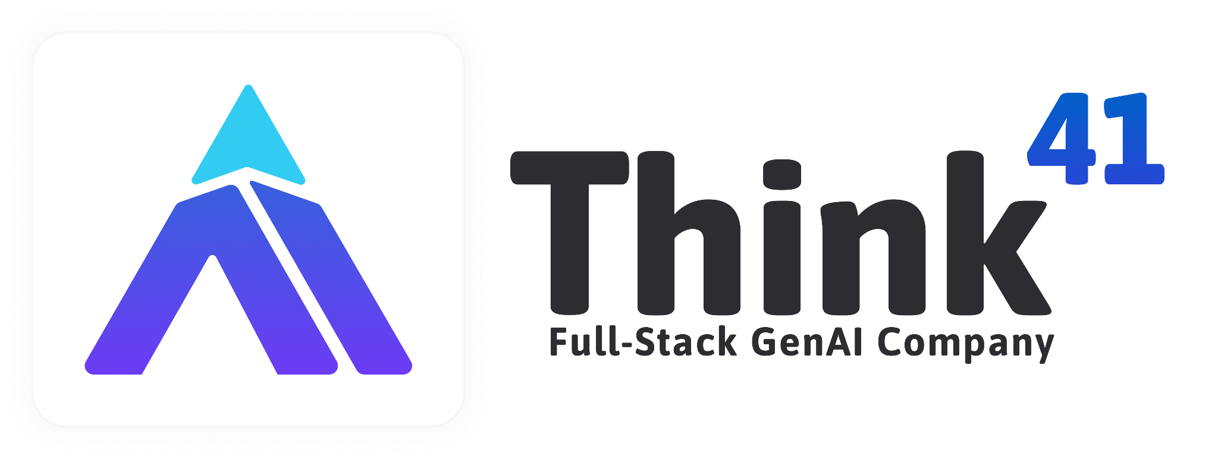
Title for the deck
Sub title
Website: www.think41.com

Slide 4

Content Outline
Topic 1
Topic 2
Topic 3
Topic 4
Topic 5
Topic 6

Slide 5

Break !!!
This is a break slide. Use it to separate content and provide context for the upcoming sections.

Slide 6
Contents
Master Slides
Typical Slide Templates
Slide Colours and fonts
Graphic Options
Icons

Slide 7










About Think41
We are a Full-Stack Generative AI Services Company
Agility of a Startup | Maturity of an Enterprise
50+
Current Team Strength
Platform Shift
Re-imagining how software will be built in post-Gen AI world
150% Productive
Think41 Fabric ensures tech & agents collab for superior delivery
75+
Worked with Fortune-500 & Tech Unicorns
Born in AI
Helping enterprises adopt latest tech to manage & mitigate risks to re-imagine the entire business processes and engagement
Re-imagine business
Show the “Art of Possible” demos and make them production ready
10
GenAI POCs developed for clients across use cases & industries
Proven Team
That built HashedIn, Born in Cloud services company, acquired by Deloitte.
Guaranteed Delivery
Our agile and outcome orientation ensures delivery at lower risk
Leadership that built 3000+ member team at HashedIn, acquired by Deloitte US
We are working with
Alliances & Tech-Stack
Our team has worked with

Slide 8








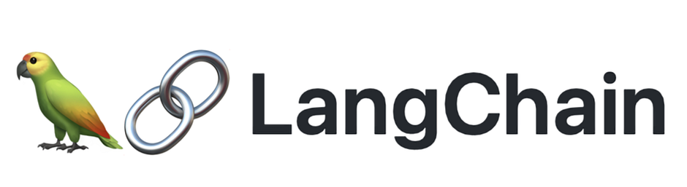
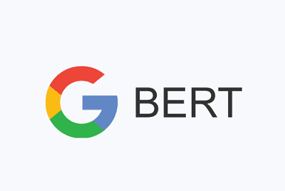











Our Service Stack
Architecture, Agents and Acceleration
Tech Stack
CORE SERVICES & OFFERINGS
Conversational AI :
Agent Dev & Workflow Automation
Product Engineering & Modernization
RAG and Agentic Development:
Assistant Systems, Recommendation Systems, Autonomous Workflows, and Prototype Development
Full-Scale Product Development, Legacy System Upgrades, AI Integration, and Technology Refresh
AUTOPODS [HUMAN + AI]
Enabled by Tailored In-House AI Assistants
LLMs:
Technical Lead
AI/ML Engineers
Software Engineers
Product Owners
Support (QA, Devops etc.)
FABRIC
Voice AI Platform Quick Agent Builder Framework
DEV41 Coding Assistant Testing Automation
Intelligence Platform Unified Search and Analytics Knowledge Mining
Software Development:

Slide 9

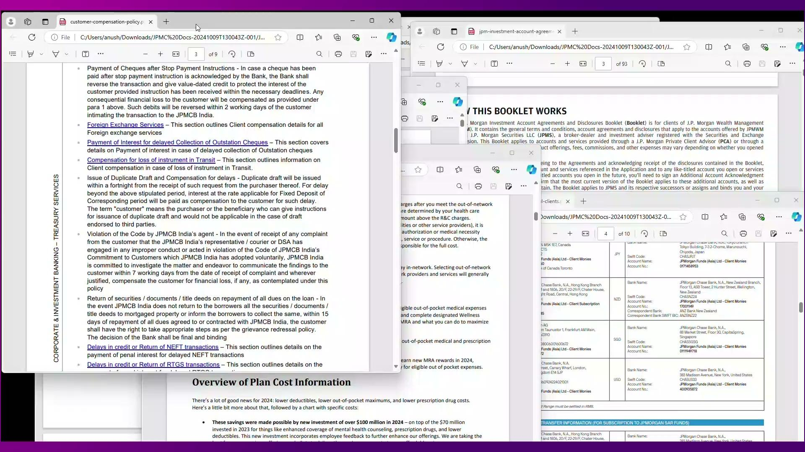
Demos - Transform Data & Documents into Conversations
Playbook & Workflow Automation
Conversation Assist:
Provides real-time text and voice suggestions from enterprise knowledge.
Handles direct Q&A Queries
Creates mini-apps for action items & checklists
Future - Create and execute multi user workflows
01
02
03
Playbook & Workflow Automation
Conversation Assist:
Provides real-time text and voice suggestions from enterprise knowledge.
Handles direct Q&A Queries
Creates mini-apps for action items & checklists
Future - Create and execute multi user workflows
01
02
03

